Slide 1

Sunflower
Group members:
U1910245 Zaynobiddinova Zebiniso
U1910278 Mirsagatova Sitora
U1910285 Saidkamolova Saidabonu
U1910292 Khamidullaeva Pirzodakhon

Slide 2
Agenda:
01
02
03
Introduction
Problems
Features
04
05
06
User Interface
Components
Conclusions

Slide 3
01
Introduction

Slide 4
Introduction
Our “Sunflower” app illustrates Android Studio Development practices with migrating a View-based app to Jetpack Compose.

Slide 5
Problems
problem when user has many flowers:
forgetting about when the seedlings were planted
How many times in a day or week should be watered
Getting complete information about the flower that user want to plant:
Features
Benefits
Care methods
Remember about flower changes

Slide 6
Features
List of plants in the garden
List of plants
Short information about each plant
Sharing with others
The list includes all plants planted in user’s garden
User can see the list of all plants with their name and picture
User can read the short description of each plant, and see the reference below
User can share plant’s description with others
Adding plant to garden list
User can add plant to garden list after planting it in the garden

Slide 7
User Interface

Slide 8
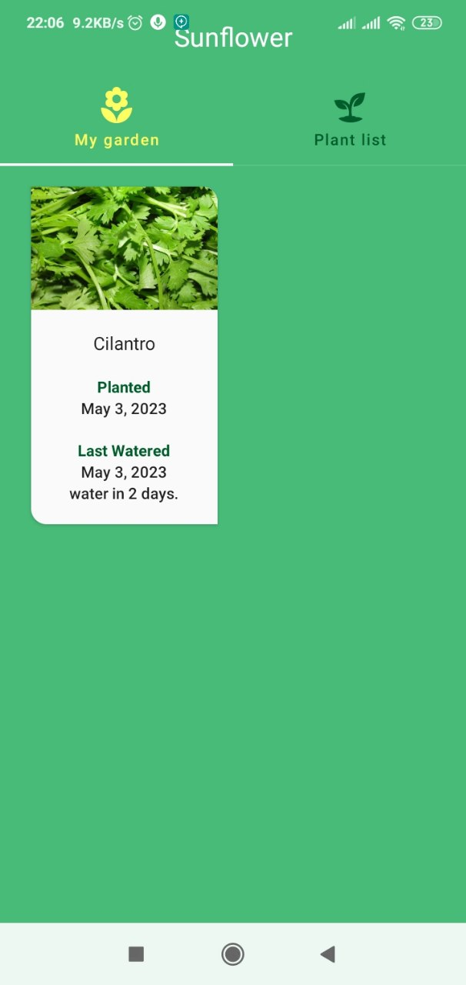
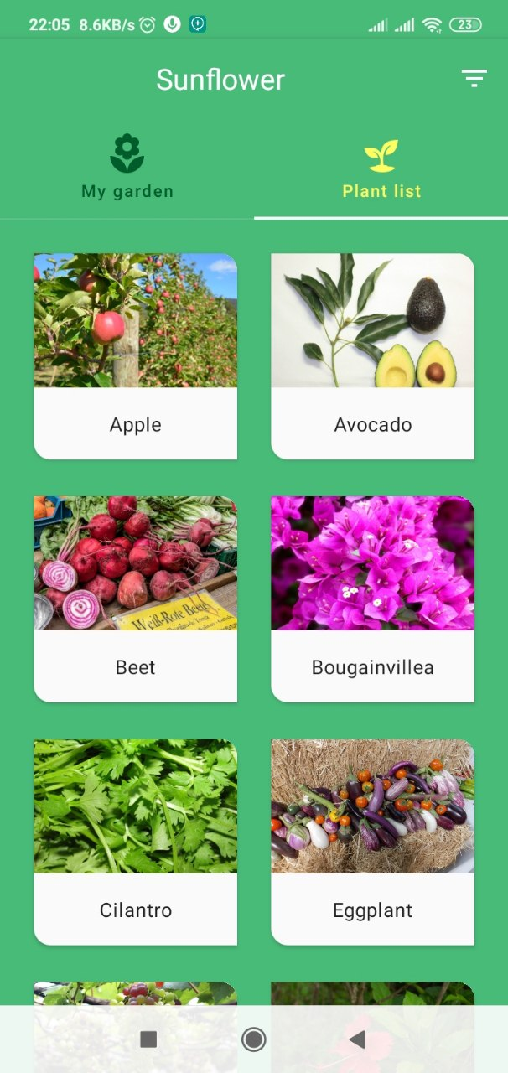
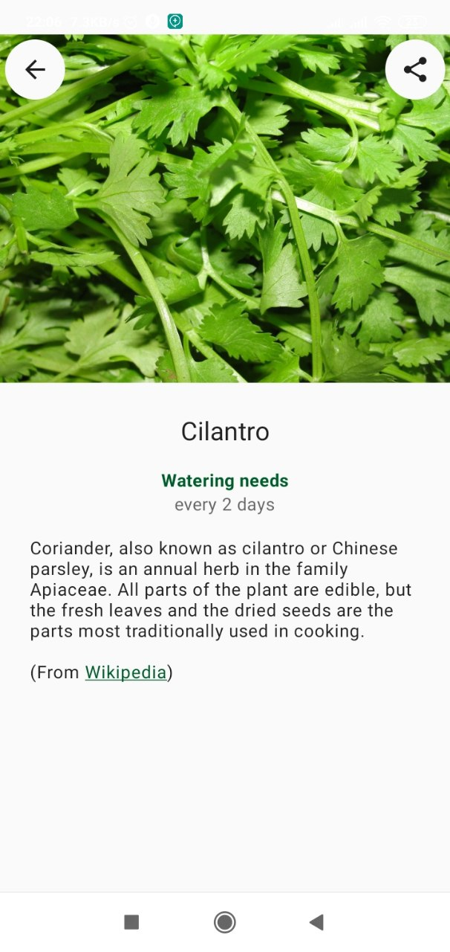

Slide 9
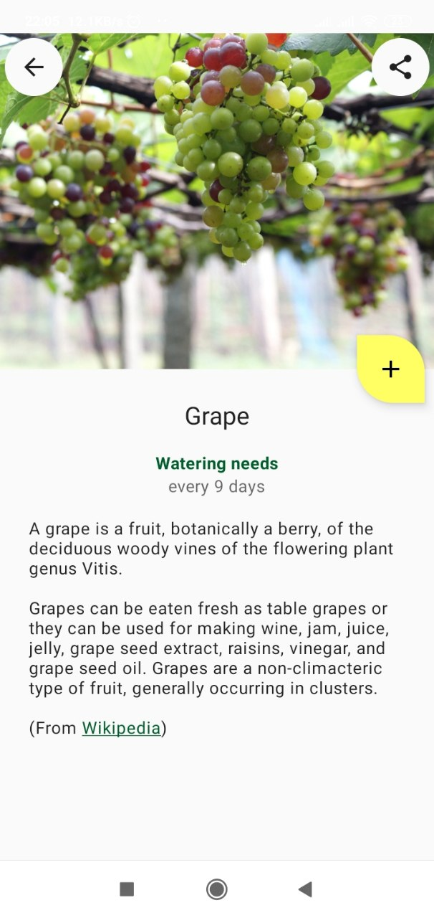
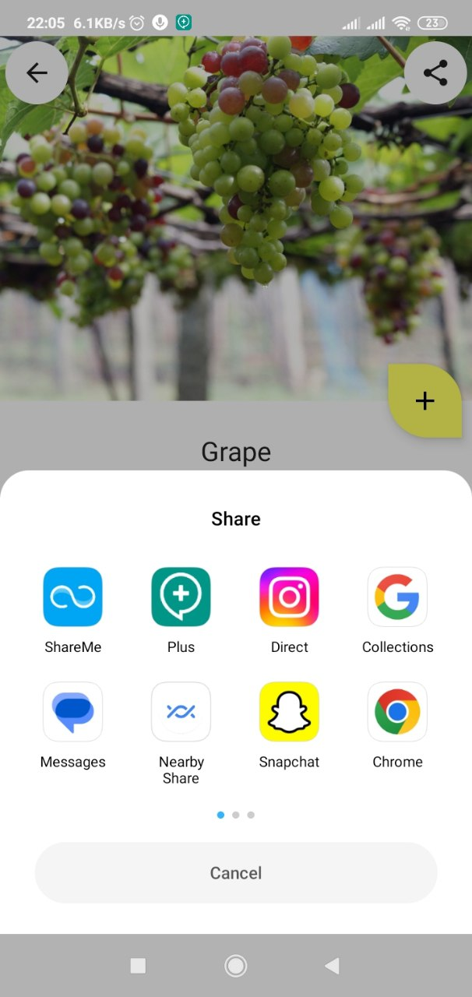

Slide 10
Components

Slide 11
Components
Jetpack Compose
RecyclerView
Snackbars
Including all libraries, resources and styles
Migrating View-based app
Shows Snackbars within Jetpack Compose

Slide 12

Conclusion

